Slide 1

Benjamin Center ArcGIS Tool Presentation
Michael Malenitza (p-f20-10), John Sheehan (p-f20-15)
Project Type: Internship, Student’s “Class Key”: p-f20-10

Slide 2



1.1 Project Description
Our project’s goal is to use the ArcGIS and python to generate Isopleth maps based on distance traveled via car or truck.
The Isochron map would create rings around two points showing how far you could travel by roadway, from these points. For example a series of 1,2,3,4, and 5 minute intervals.
The reasoning for creating this API is to help allow local counties and governments figure out the new locations for building fire departments and EMS response buildings. Overall this will be a useful urban development tool.

Slide 3
1.2 What is an Isochron Map?
An isochron map in geography and urban planning is a map that depicts the area accessible from a point within a certain time threshold.An isochrone (iso = equal, chrone = time) is defined as "a line drawn on a map connecting points at which something occurs or arrives at the same time".

Slide 4
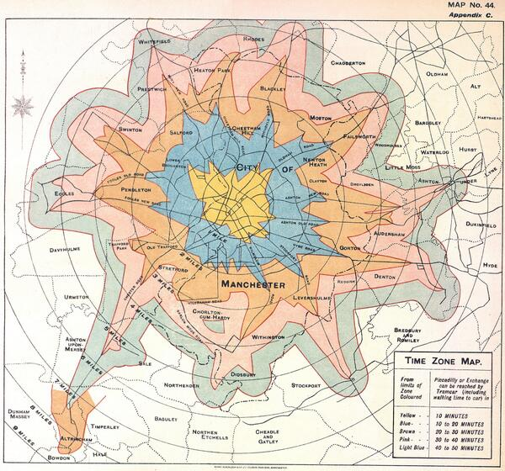
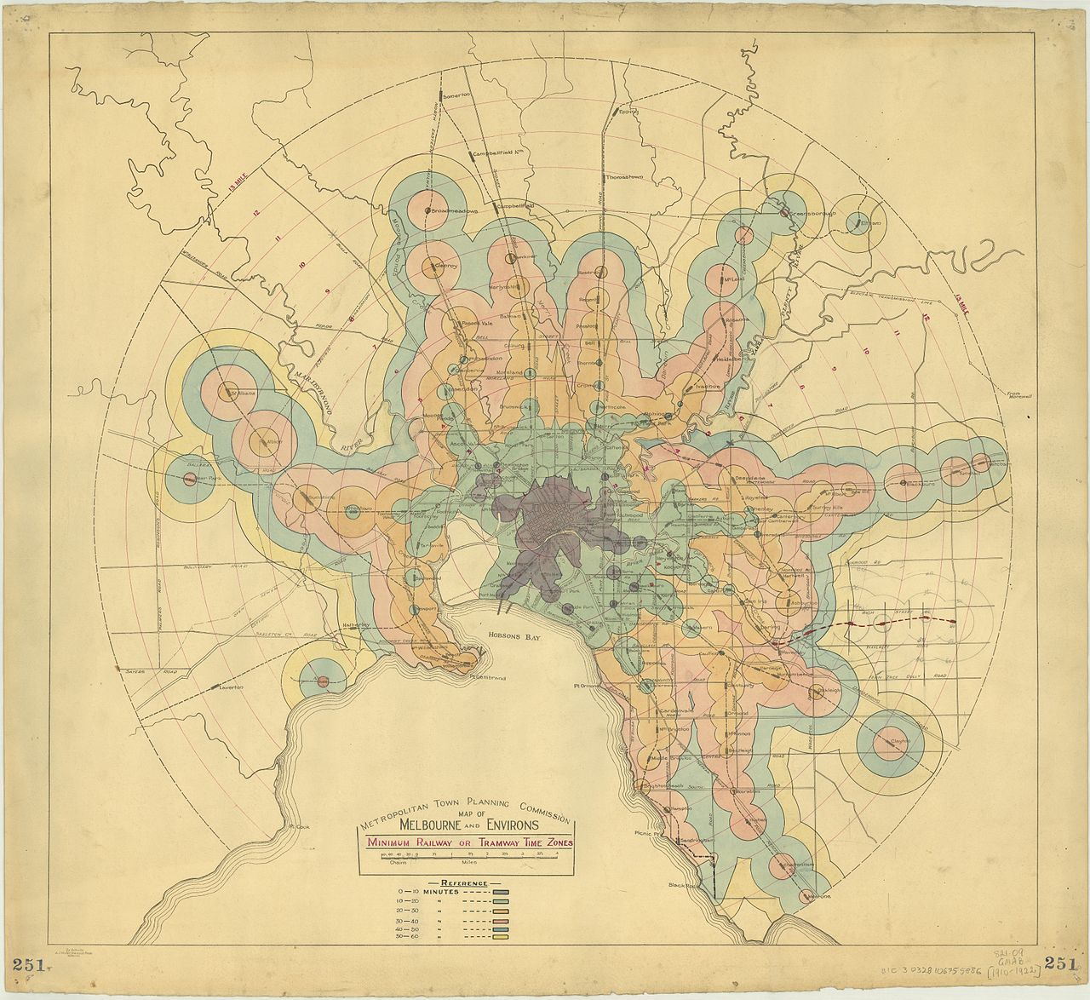
1.2 Isochron Examples

Slide 5

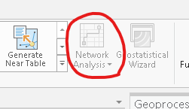
1.3 Technical requirements
Utilizing ArcMaps Network analyst functions within python is our project's biggest technical requirements.
Our script consists of creating a service area layer, which is in the Network Analyst toolkit. This service area layer, allows us to specify which parts of the map data we’d like to focus on. Objects such as firehouses (facilities), and streets are the pieces of data we mostly manipulate. The visual aspect of the software which we create, is created from our break values, which displays a ratio of distance traveled over time.

Slide 6
1.4 Your Responsibilities
Our responsibilities consist of utilizing ArcGIS’s network analysis tools to create a script and graphical user interface. This script would utilize arcPy, a python site package which allows us to perform our geographic analysis. The GUI would allow a user, to enter specific local variables, such as our time intervals, and facilities.

Slide 7


2.1 Related Technologies
ArcMap is the central application used within ArcGIS. ArcMap allows you to explore, display, and study your datasets. It does this within a collection of layers of data, and other map common elements in map.
Python Is the language that utilizes ArcGIS to create and display our time/travel interval.
The Network Analyst Extension within ArcGIS allows us to create layers of data.

Slide 8
2.2 Newly Learned Skills / Technologies
ArcGIS is a software we’ve never used before, and none of us have used any mapping and analysis software also, so the entire experience was anomalous to what we’ve done in school.
The Network Analysis Tools allow us to automatically utilize the analysis functions provided within ArcGIS. This merged our previous python knowledge, with an unfamiliar software.

Slide 9
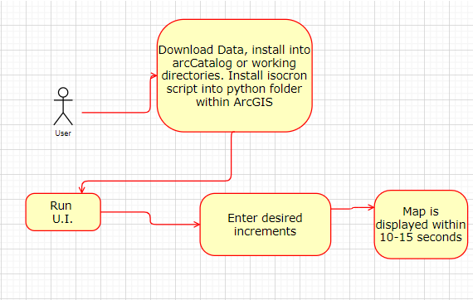
3.1 System Architecture and Design

Slide 10
3.2 Components
Isocron.py | The Python Script that generates the map.
SRFD.gbd | GeoDatabase of streets and locations

Slide 11
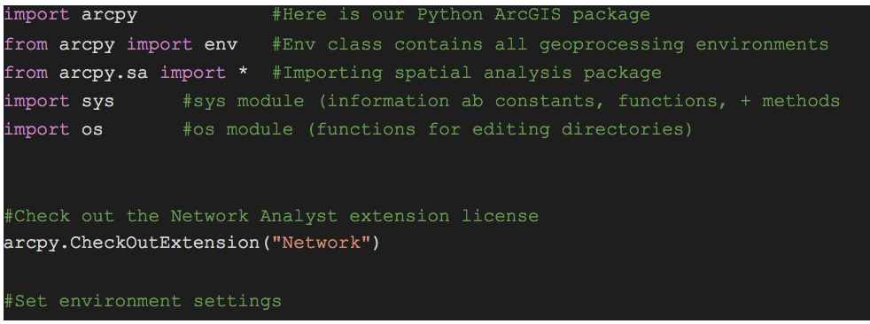
4. Software / Code Description

Slide 12
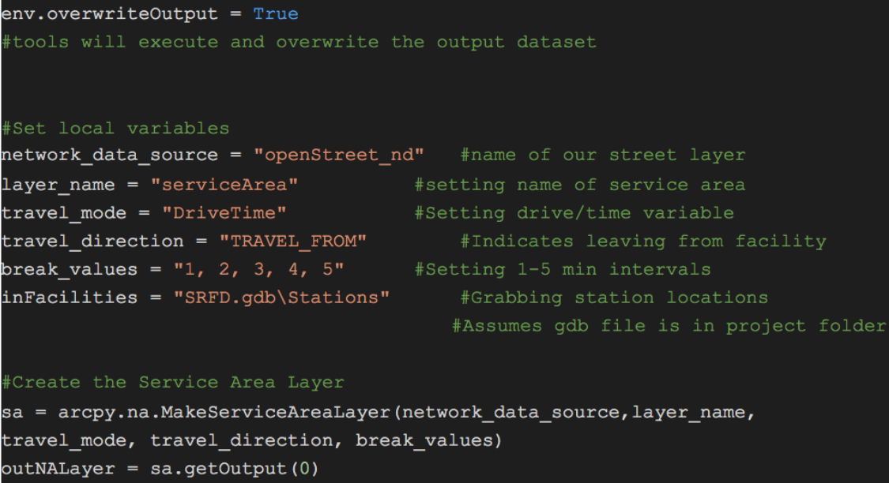

Slide 13
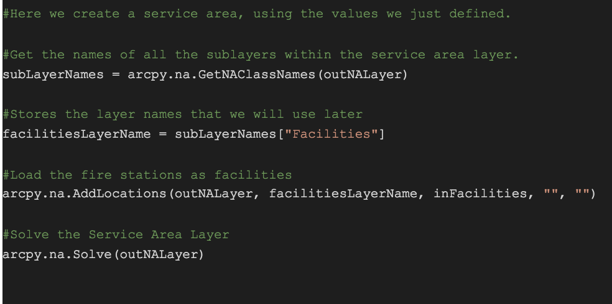

Slide 14
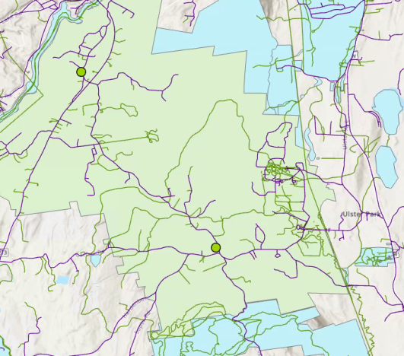
5.1 Test Function Demo
ArcGIS Map of New Paltz Before
running our tool. Notice the green
Circles which indicate our facilities,
in our case these are fire
departments.

Slide 15
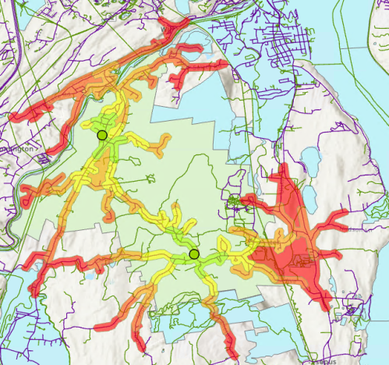
5.2 Test Function
After Running the tool
our intervals are being displayed within
color, starting bright yellow, going
darker orange, to red, in correlation with
the time it would take to travel from
the firehouse.

Slide 16
6. Professional and Career Benefits
Working with a team to develop a project will be a key skill which will be necessary in larger project development. Working together we learned how to organize, and divide up work, along with learning how to teach and learn from each other to complete our project.
Utilizing ArcGIS’s Network Analyst allowed us to get hands on experience with manipulating data, and creating spatial analysis tools. We used python to utilize the Spatial Analyst functionality, allowing us to cross our knowledge of Python while getting fresh eyes on a new software.

Slide 17
7. Conclusions
ArcGIS is a useful tool for geographic analysis. Remote work made it difficult to interact with the schools computers, as we faced many obstacles we had to overcome throughout our project. Initially we focused on how to use ArcGIS, although we soon realized we were missing a key extension to the software, Network Analysis. After the school installed this, we realized we also didn’t have python installed on the computers which meant we had to jump through some hoops for testing, trying on the schools VDI, and many other computers in different buildings. Overall we learned how to work together, and completed our script.

Slide 18
8. References
ArcGIS Pro: https://www.esri.com/en-us/arcgis/products/arcgis-pro/overview
ArcGIS Spatial Analysis: https://www.esri.com/en-us/arcgis/products/arcgis-spatial-analyst/overview
ArcPy: https://pro.arcgis.com/en/pro-app/arcpy/get-started/what-is-arcpy-.htm

Slide 19
9. Appendixes
1. Problem Description - 1.1 Business Context and Goals .……...……... page 02
1.2 Technical Requirements ……….………………………………………………..…. pages 03-05
1.3 Your Responsibilities ……...…………………………………………………………. page 06
2. Technologies - 2.1 Related Technologies ….………………………………….. page 07
2.2 Newly Learned Skills/Technologies ……………………………………..….…. page 08
3. Design - 3.1 System Architecture ………………….…………...………………. page 09
3.2 Components ……………………………………….……………………..……………… page 10
4. Software/System Description ……………………………………………….……... pages 11-13
5. Test Results/Observations
5.1 Experiment/Observation # 1 (Performance) ……………...………………. page 14
5.2 Experiment/Observation # 2 (Quality) …………………………….…………. page 15
6. Professional and Career Benefits ……………………………………..…………. page 16
7. Conclusions ………………………….…………………………………………………...…. page 17
8. References ………………………….…………………..……………………………………. page 18
9. Appendixes …………………….………………….…………………………………………. page 19

